Slide 1
PROBLEM SOLVING AND PROGRAMMING USING PYTHON
Mr.Panduraju Pagidimalla
Assistant Professor, Dept of AIML

Slide 2
Unit-I: Introduction to Python

Slide 3
Outline
Structure of a Python Program
Python Interpreter and Script mode of programming
Python program execution steps

Slide 4
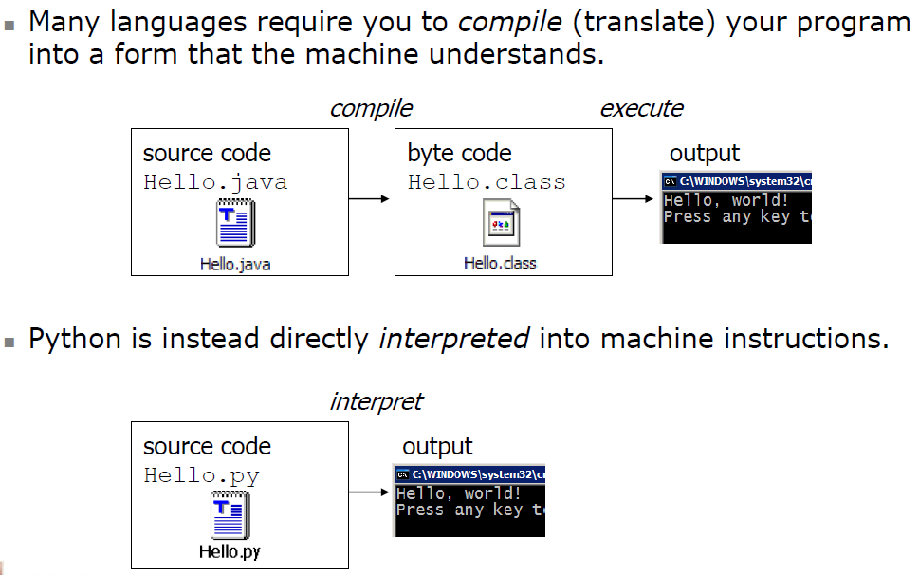
Compiling and interpreting

Slide 5
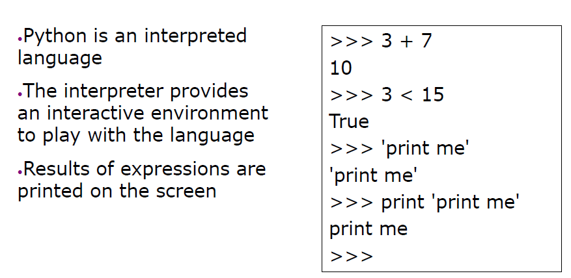
The Python Interpreter

Slide 6
Structure of a Python Program

Slide 7
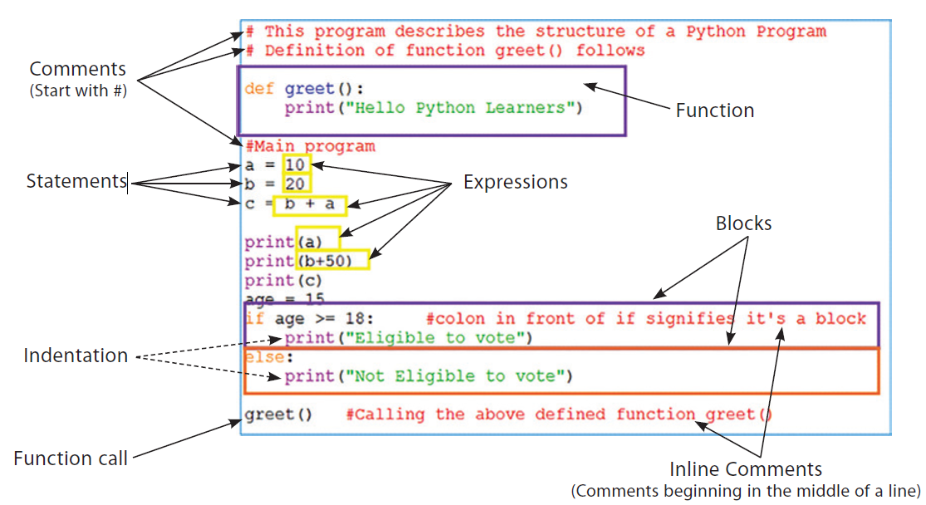
Several components of a basic Python program

Slide 8
Comments: Comments are the additional information provided against a statement or a chunk of code for the better clarity of the code. Interpreter ignores the comments and does not count them in commands.
Symbols used for writing comments: Hash (#) or Triple Double Quotation marks (“””)

Slide 9
Hash (#) is used in writing single-line comments that do not span multiple lines. Triple
Quotation Marks (‘’’ or “””) are used to write multiple-line comments.
Three triple quotation marks to start the comment and again three quotation marks to end the comment.

Slide 10
Expressions: An expression represents something, like a number, a string, or an element. Any value is an expression.
Statements: Anything that does something is a statement.
  Any assignment to a variable or function call is a statement.
  Any value contained in that statement is an expression.

Slide 11
Functions: Function is a set of instructions defined under a particular name, which once written can be called whenever and wherever required.
Block(s): A block refers to a group of statements which are part of another statement or function.
  All statements inside a block are indented at the same level.
Import statements are used to include library files to the python program

Slide 12
Python Interpreter and Script mode of programming

Slide 13
Execution Modes
There are two ways to run a program using the Python interpreter:
  a) Interactive mode
  b) Script mode

Slide 14
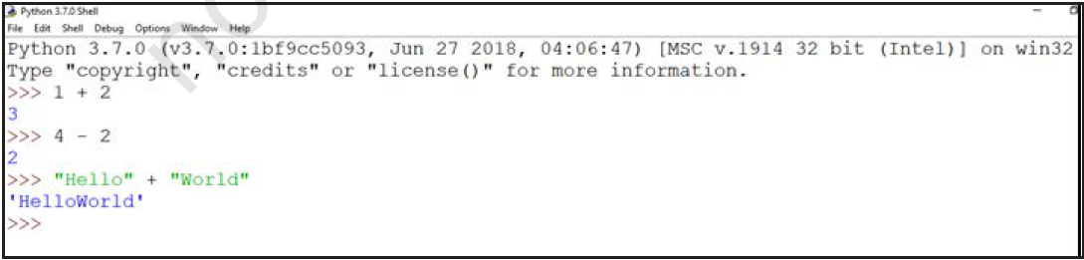
a) Interactive Mode
In the interactive mode, we can type a Python statement on the >>> prompt directly. As soon as we press enter, the interpreter executes the statement and displays the result(s),

Slide 15
Working in the interactive mode is convenient for testing a single line code for instant execution.
  But in the interactive mode, we cannot save the statements for future use and we have to retype the statements to run them again.

Slide 16
b) Script Mode
In the script mode, we can write a Python program in a file, save it and then use the interpreter to execute the program from the file.
  Such program files have a .py extension and they are also known as scripts.
Python scripts can be created using any editor. Python has a built-in editor called IDLE which can be used to create programs.

Slide 17
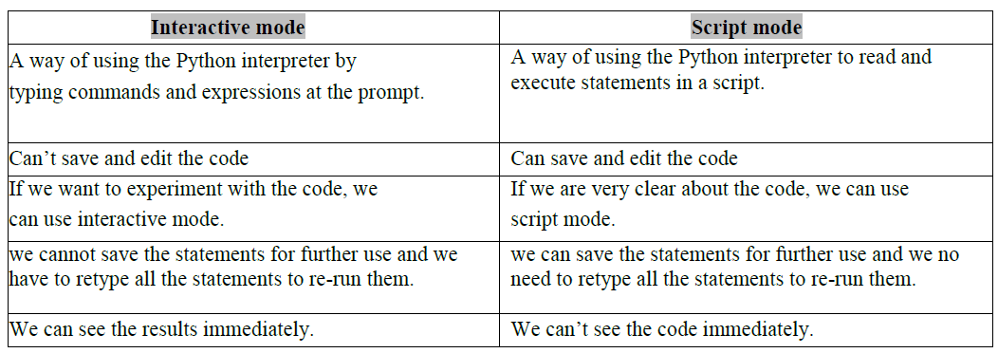
Differences

Slide 18
Python program execution steps

Slide 19
Steps to execute a Python program in script mode
Open Python IDLE
Create a New Python File: File → New File (or press `Ctrl + N`).
Write Your Python Code: print("Hello, World!")
Save the File: File → Save (or press `Ctrl + S`).
  -Choose a location and a filename with a `.py` extension, e.g., `hello.py`.
Run the Program: Run → Run Module (or press `F5`). Output: Hello, World!
Exit or Continue Programming:

Slide 20
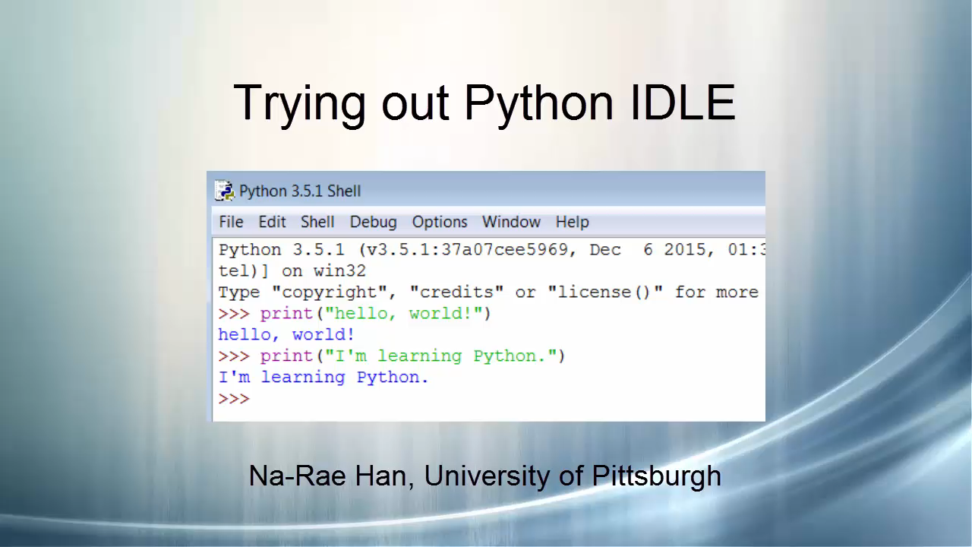

Slide 21
THANK YOU !

